Slide 1

Sustainable Mechanical Engineering Education:
The Way Forward
33rd International Conference and Annual General Meeting
The Nigerian Institute of Mechanical Engineers
Steffan Hotel & Suites Channel 1, Rayfield, Jos, Nigeria :: 20-23 October 2020
Promoting Quality Mechanical Engineering Education and Practice for Sustainable Development
What do engineers need to learn for sustainable development?
Professor Ir. Dr. Mohammad Yeakub Ali
P.Eng (Bangladesh), P.Eng (Malaysia), C.Eng (UK), C.P.Eng (Australia)
Leader: Sustainable Built Environment Research Thrust
Mechanical Engineering Programme Area
Faculty of Engineering, Universiti Teknologi Brunei
Tungku Highway, Gadong BE 1410, Brunei Darussalam
E-mail: yeakub.ali@utb.edu.bn mmyali@deerhillpublishing.com

Slide 2

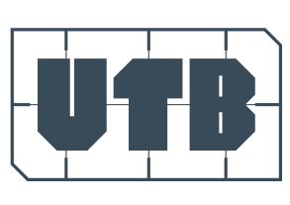

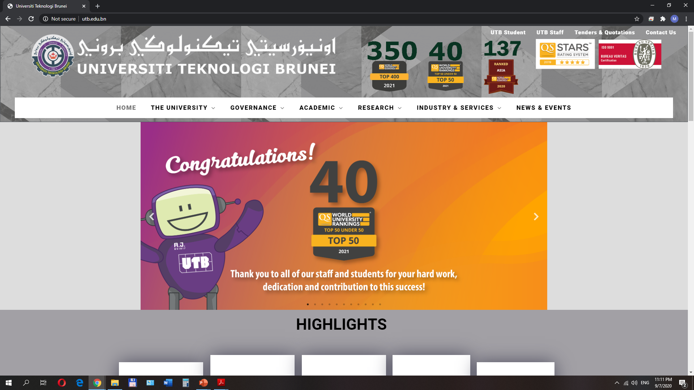
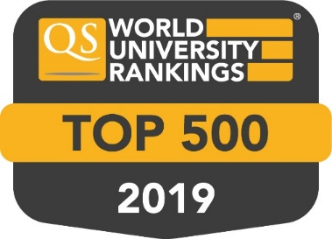
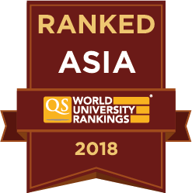
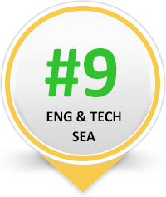
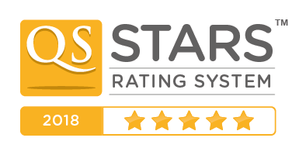

at a glance

Slide 3

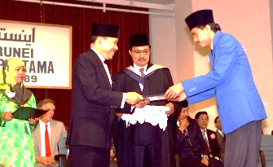
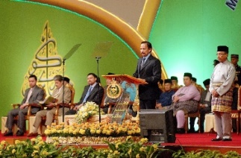
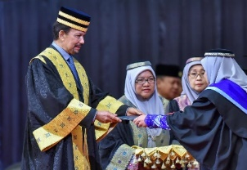
1986
Establishment
2010
Introduction of Masters by Research and PhD
2014
Establishment of the UTB School of Business and School of Computing & Informatics
2016
Renaming to Universiti Teknologi Brunei
Establishment of the School of Applied Sciences and Mathematics
2015
Introduction of Masters by Coursework
First cohort of PG students graduated
2017
ACCA Accreditation for BAIS
4 Star QS Star Rating
CE Programmes accredited by JBM
UTB Ranked #165 in Asia
School of Design
2008
University
2013
First cohort of degree students graduated
2005
Crown Prince CIPTA Award
Notes:
2004
2008
2009
As a university, UTB began offering four local undergraduate degree programmes.
The 1+3 articulation degree programmes with the University of New South Wales in Petroleum Engineering and Chemical Engineering commenced in UTB.
2010
The UTB Constitution was gazzetted.
2011
Masters by Research and PhD programmes began to be offered.
Part-time study mode for Business and Computing undergraduate degree programmes began to be offered.
UTB enrolled the last student intake of the UTB-QUB twinning programmes in Civil Engineering.
UTB recognized as a Cisco Networking Academy.
The Centre for Road Safety Studies (CRoSS) was established in UTB.
2012
Nine new undergraduate degree programmes and two new Foundation Degree programmes began to be offered.
The format of the articulation degree programmes with UNSW was changed from 1+3 to 2+2.
UTB enrolled the last student intake of the HND programmes in Business and Computing.
‘The Pearl’ building that accommodates the Petroleum and Chemical Engineering Programmes was officiated. The construction of the building was funded by Brunei Shell Petroleum SdnBhd and Shell E&P.
2013
The construction of UTB Phase 3 was completed.
Five new undergraduate degree programmes began to be offered
Fully-local undergraduate degree in Chemical Engineering began to be offered
The UTB Material Testing Centre was officiated.
The first intake of UTB local undergraduate degree programmes graduated.
Installation of HRH the Crown Prince as the Pro-Chancellor of UTB by His Majesty the Sultan and Yang Di-Pertuan of Brunei Darussalam.

Slide 4


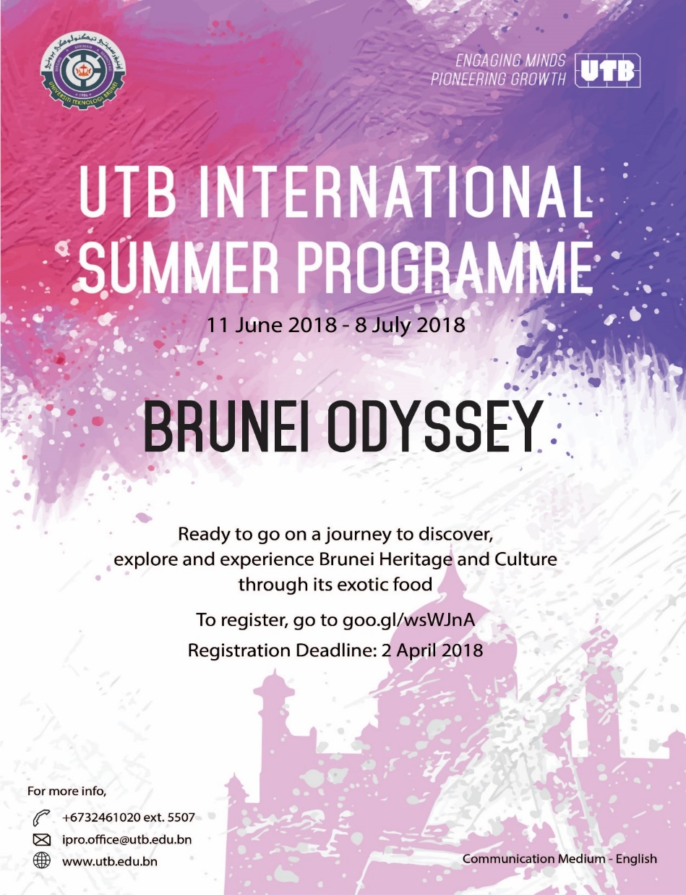
www.utb.edu.bn

Slide 5
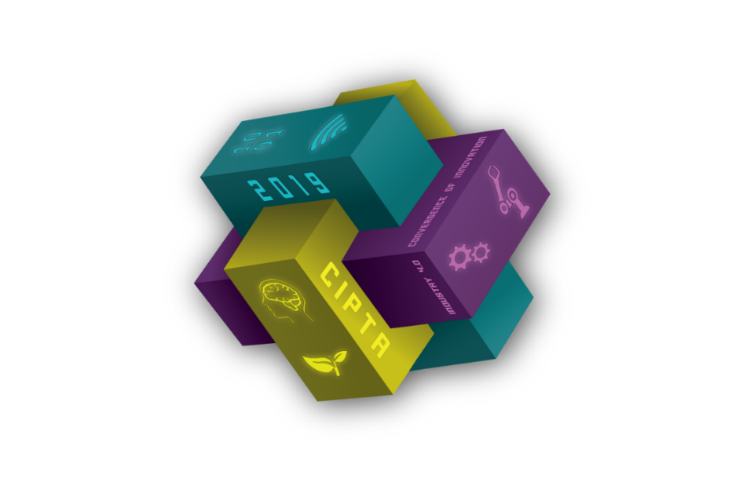
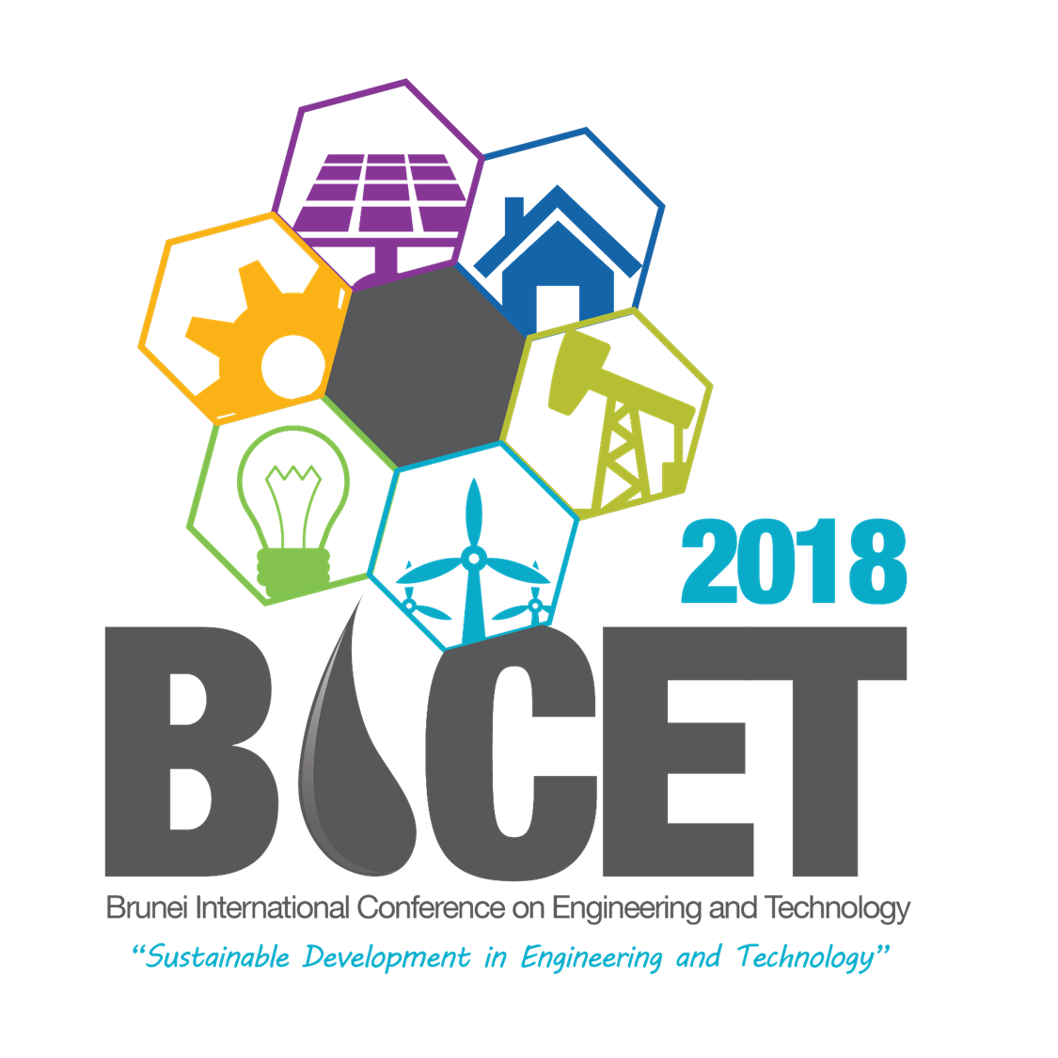
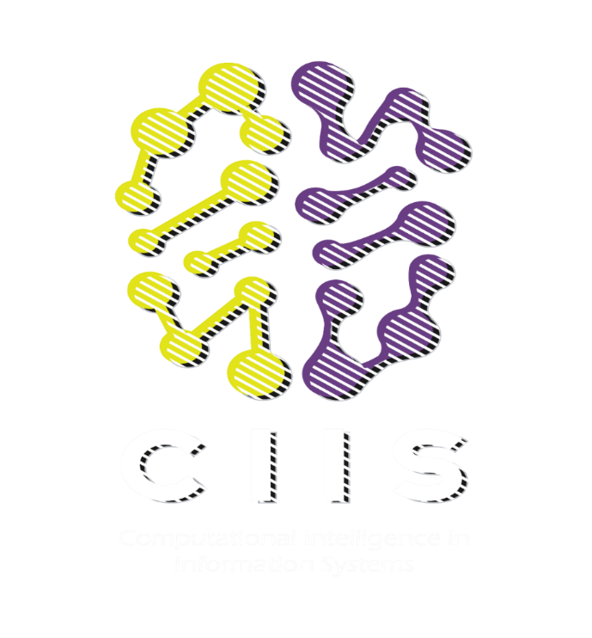
08-10
November 2021
CIPTA 2021
2021
UNIVERSITI
TEKNOLOGI
BRUNEI
16 – 18
November 2020
www.utb.edu.bn

Slide 6
Table of Content
Introduction
Market Demand & Competition
Lean & Clean: The Toyota Way
Sustainability in Education
  Curriculum
  Role of Engineer
Conclusions

Slide 7
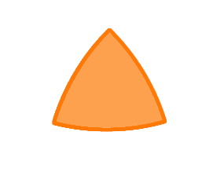
Engineering Sustainable Development: Balance of the three elements
Environmental
Economic: what things cost - and how to make a business out of providing infrastructure, goods or services
Environmental: what impact those things have on nature and the earth’s support systems - which are finite
Social: how those things serve the needs and quality of life of people and their communities
Sustainable Development
Economic
Social
Over the last 50 years, ‘development’ - comprising engineering projects, and products - has benefited large numbers of people, world wide but:
The way we have been doing our development is often “unsustainable” - in social and environmental terms
This leads to real fears about the security and quality of life for the future generation.
Notes:
Notes
• The concept of sustainable development involves all three aspects of a project equally. i.e. the environmental, the social and the economic. It is not enough to consider environment alone. This is often referred to as the 'Triple bottom Line'.
• The triple bottom line is shorthand for environmental protection, economic development and social progress. Social equity issues are particularly challenging for engineers to get to grips with.
• Sustainable development is often represented by showing these three dimensions as a Venn diagram with sustainable development as the overlapping segment in the middle. What this shows is that a balance between the three elements is required. However this can also imply that some aspects are beyond sustainable development considerations.

Slide 8
Sustainability Frame of Reference
Consumption with increased efficiency
Consumption at “today’s rate”
Rate of
Consumption*
Required Consumption Rate
to reach Sustainability
Sustainable rate
Any resource: energy,
material, water, air …
Today
Future
How do we achieve this
“slope change”?

Slide 9
Marketplace Pressure for Sustainable Manufacturing
Wal-Mart president Lee Scott (March 2008 Global Sustainability Newsletter):
“We will require all suppliers who work with us through global procurement, who are domestic or importers, or who manufacture Sam’s Club or Wal-Mart private brands, to demonstrate that their factories meet specific environmental, social and quality standards. We have already started doing this, and we hope to extend the requirements to all of the above-mentioned suppliers within three to five years. We will only work with suppliers who maintain our standards throughout our relationship, so certification and compliance will be part of our supplier agreements. We will favor – and in some cases even pay more – for suppliers that meet our standards and share our commitment to quality and sustainability. Paying more in the short term for quality will mean paying less in the long term as a company.”
Market Pressures → Operations Headaches
Shifting customer requirements impact business every day
Greg Gorbach (2008): North American Plant-to-Enterprise Conference

Slide 10
Lean & Clean

Slide 11
Push System
Pull System
Production line is controlled by the last operation (Kanban)
Every worker maximizes own output, making as many products as possible
Lean Organizations
Building Lean Organization
Transitioning to a Lean system can be difficult
Build a culture of continual improvement
Open communication
Demonstrated respect for people
Gemba walks to see work being performed
Understanding the customer and the customer's expectations
Functional areas communicate and collaborate to make sure customer expectations are met
Implement the tools of Lean throughout the organization

Slide 12
Environmental Impact of Manufacturing
Manufacturing is dominant in its environmental Impact in toxic chemical release, waste generation, energy consumption and greenhouse gas emission
×

Slide 13
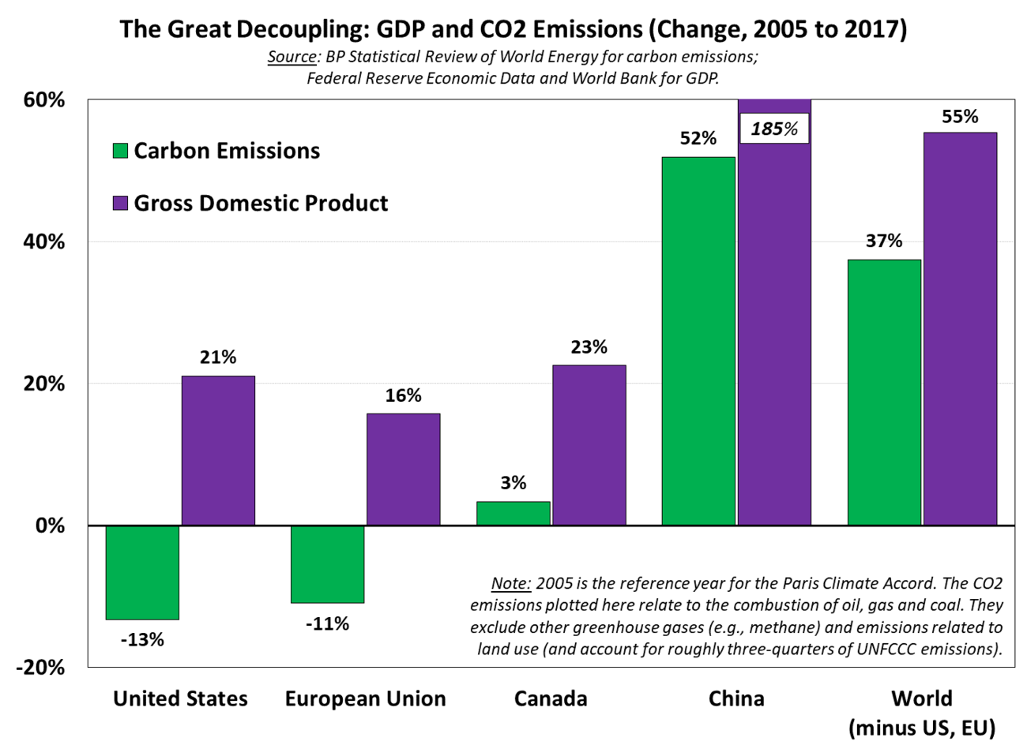
Global Greenhouse Gas Emission

Slide 14
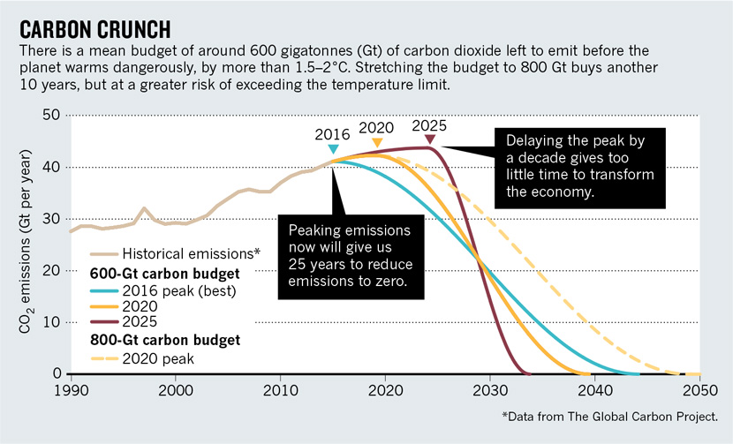
Rapid Reduction of Carbon Emissions
For example, as the figure shows, if emissions were to peak in 2025, they would have to decline to zero globally in a mere 10 years. Even a 2020 peak still requires net-zero global emissions 20 years later in 2040
https://www.carbonbrief.org/mission-2020-new-global-strategy-rapidly-reduce-carbon-emissions

Slide 15
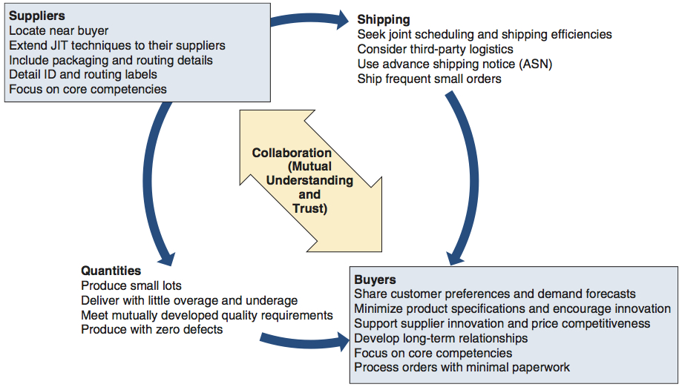
The Lean Way
Just in Time (JIT)
Kanban
5S & 5Why
Genchi Genbutsu (go & see for yourself)
….
JIT Partnerships

Slide 16
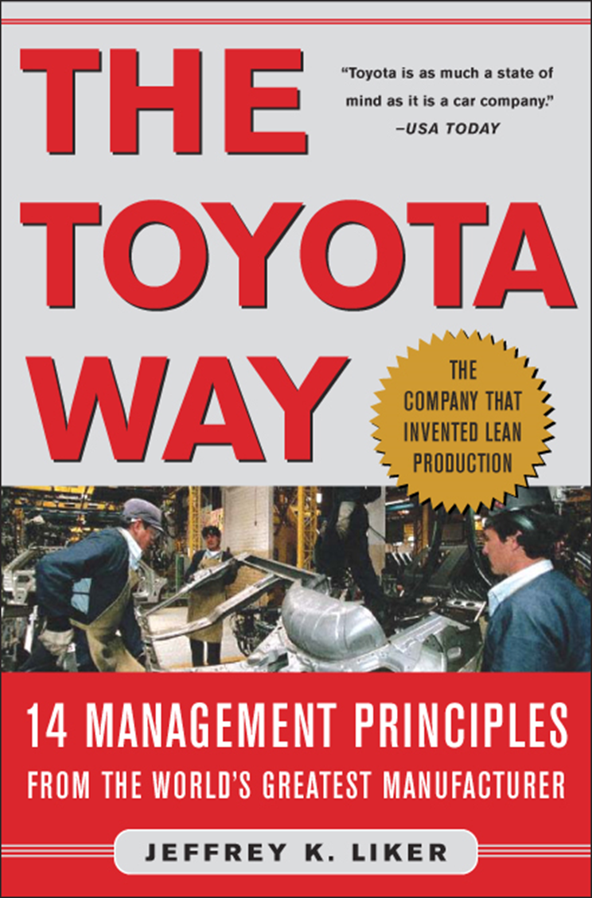
Why Learn from Toyota?
Fastest product development process in auto business
Consistently among top plants in productivity
Consistently award winning quality levels
Has triggered a global transformation of manufacturing to the Toyota Production System “Lean Manufacturing.”
Professor Dr. Jeffrey K. Liker
Industrial & Operations Engineering
The University of Michigan

Slide 17
  The Toyota Way
  14 Management Principles
Base your management decisions on a long-term philosophy, even at the expense of short-term financial goals.
Create a continuous process flow to bring problems to the surface.
Use “pull” systems to avoid overproduction.
Level out the workload (heijunka). (Work like the tortoise, not the hare.)
Build a culture of stopping to fix problems, to get quality right the first time.
Standardized tasks and processes are the foundation for continuous improvement and employee empowerment.
Use visual control so no problems are hidden.
Use only reliable, thoroughly tested technology that serves your people and processes.
Grow leaders who thoroughly understand the work, live the philosophy, and teach it to others.
Develop exceptional people and teams who follow your company’s philosophy.
Respect your extended network of partners and suppliers by challenging them and helping them improve.
Go and see for yourself to thoroughly understand the situation (genchi genbutsu).
Make decisions slowly by consensus, thoroughly considering all options; implement decisions rapidly (nemawashi).
Become a learning organization through relentless reflection (hansei) and continuous improvement (kaizen).

Slide 18
Toyota Leadership Model
Toyota Leaders
Develop Exceptional
Associates and Teams who
follow the Toyota Way
Builder of Learning Organization
Group Facilitator
Bottom-up
(Development)
“You’re Empowered”
“Here is our purpose and direction--I will guide and coach”
Develop Leaders
who Live
the Philosophy
Continuously Develop
People
Bureaucratic Manager
Task Master
Top-Down
(Directives)
Challenge the
Extended Network of
Partners to Grow
“Here is what to do and how--do it!”
“Follow the Rules”
General Management
Expertise
In-depth Understanding of Work

Slide 19
Education

Slide 20
Role of Mechanical Engineers
Sustainable Manufacturing
Energy Efficient Manufacturing
Key technologies
Standards
Education
Sustainable Critical Infrastructures (SCIs)
Critical infrastructure is a term used by governments to describe assets that are essential for the functioning of a society and economy.
SCIs receive nowadays the highest priority in strategic planning all over the world.
Example:
Electricity generation, transmission and distribution;
Gas & gas production, transport and distribution;
Water supply, heating, public health, security services, …

Slide 21
Do You Agree?
Engineering is defined by the Accreditation Board for Engineering and Technology (ABET) as the “profession in which a knowledge of the mathematical and natural sciences gained by study, experience, and practice is applied with judgment to develop ways to utilize, economically, the materials and forces of nature for the benefit of mankind” (ABET, 2002).
Engineers should be concerned with the ‘purpose’ and social dimensions of technology application?
Extend our professional ‘ethic’ to include the environmental and social consequences?
We are not (yet) educating our engineering graduates to deal with the key issue of the 21st Century…..
Notes:
Notes
• ESD: Engineering for Sustainable Development

Slide 22
Integration of Science, Technology, Engineering & Mathematics (iSTEM)
Science
Sci.
Sci.
Technology
Tech.
Eng.
Tech.
Eng.
Engineering
Math.
Math.
Mathematics
Four Separate Subjects
Partial Integration of Subjects
Integrated STEM
Develop standards to develop the content for what every student should know for sustainable development.
Prepare teachers to teach sustainable development.

Slide 23
Traditional Concern
Institute of Higher Learning
Today’s Additional Concerns:
Nano-Bio-Info
Large complex systems
An entire new life-science base
Astounding computation & storage capabilities
Innovation & Leadership
Teamwork across disciplines, fields, nations & cultures
Experiential learning
Entrepreneurship
Product development & manufacturing
Sustainable development
Graduates must be global engineers
  Technically adept
  Broadly knowledgeable
  Innovative & entrepreneurial
  Commercially savvy
  Multilingual
  Culturally aware
  Able to understand world markets
  Professionally flexible
How to make the first year exciting,
How to communicate what engineers actually do,
How to develop an understanding of business processes, and
How to get students to think about ethics and social responsibility.
Why? Because the world is changing….

Slide 24
A New Century
20th Century:
  Physics, Electronics, High-Speed Communications & Transportation
  Scientists discovered.
  Engineers created.
  Doctors healed.
21st Century:
  Biology and Information,
  Energy, Water, and Sustainability
  Dynamic with exciting frontiers and grand challenges
  Science, engineering, and medicine are totally interdependent & blending together in new ways
Engineering to include, interact with, and serve:
People
Economies
Business
Law
Politics
Culture …

Slide 25
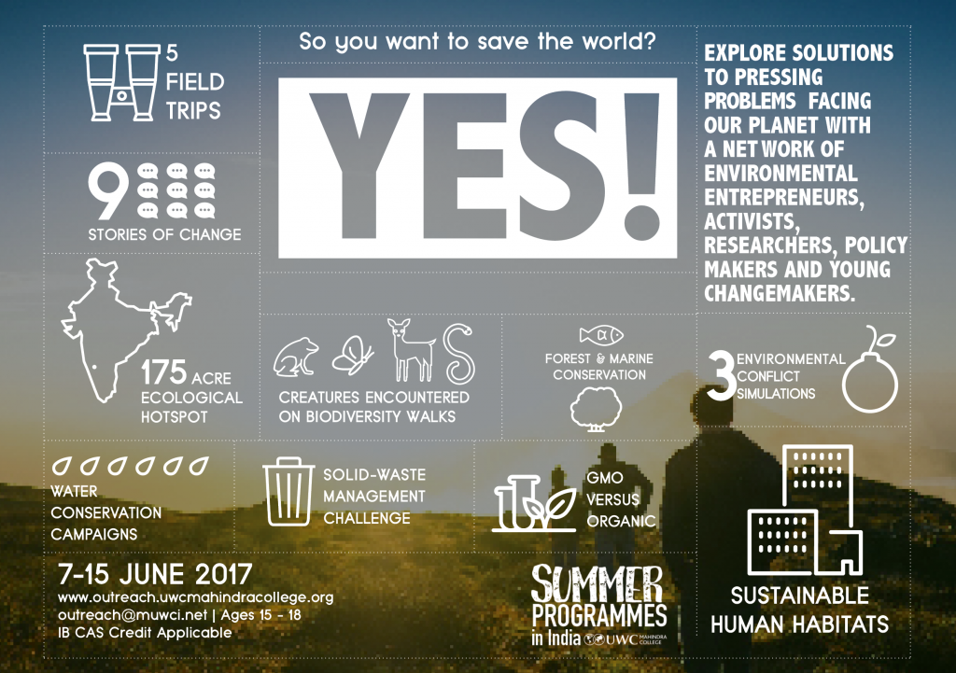

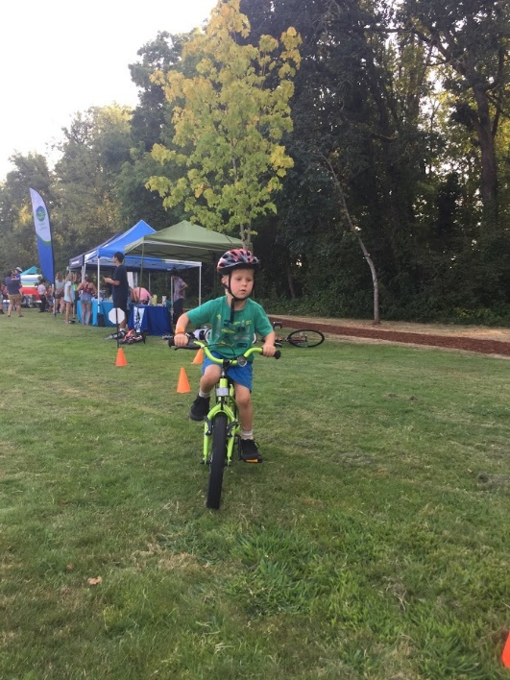
Engineering Grand Challenge
Energy
Environment
Global Warming
Sustainability
Reducing Vulnerability
to Human &
Natural Threats
Improve Medicine &
Healthcare Delivery
Expand & Enhance
Human Capability
& Joy
The public and policy makers need to understand what engineers do and can do.
Making engineering schools exciting, creative, adventurous, rigorous, demanding, and empowering environments for sustainability.
  Curriculum
  Summer Camp
  Seminar/Workshop

Slide 26
Sustainability in Engineering Curriculum
Engineering schools have adopted two approaches
  Horizontal Integration:
    sustainability coursework material is integrated into several courses across the curriculum,
    an existing curriculum course can be revised to include some coverage that is associated with environmental and/or social issues.
  Vertical Integration:
    new sustainability courses are added into the curriculum.
    appropriate sustainable development material that matches the nature of the existing course can be interwoven with the original course material.
In the third approach, sustainable development integrated into courses can be offered as a specialization or as a major program at the university.
Issa, R. (2017). Teaching Sustainability in Mechanical Engineering Curriculum. Athens Journal of Technology and Engineering, 4(3), 171-189.

Slide 27
Core
Energy based course in Thermo-Fluid
to apply heat transfer and fluid mechanics concepts to analyze and design thermo-fluid systems with economic and sustainability considerations.
apply guidelines to optimize the thermodynamic effectiveness of the cycles from exergy point of view,
cost associated with processes and equipment, and the operating conditions and
the guidelines for improving the efficiency and the cost effectiveness.
Electives
Elective courses are to examine the eco-aspects of materials and introduces sustainability in engineering design.
Analyze and understand the multidimensional aspects of sustainable development.
Examine the damaging impacts on the environment and the ecosystem.
Identify the factors used to measure the environmental impacts.
Examine the eco-aspects of materials production and use.
Apply the economics input-output environmental life cycle assessment
Design for sustainability
Issa, R. (2017). Teaching Sustainability in Mechanical Engineering Curriculum. Athens Journal of Technology and Engineering, 4(3), 171-189.

Slide 28
Conclusions

Slide 29
Areas where Mechanical Engineers Can Contribute
Sustainable Manufacturing
Sustainable Critical Infrastructures
Sustainability vs. Competitiveness;
Product life-cycle management;
Environ. conscious design & mftg
Energy/Utilities management;
Total quality management;
Waste management;
Reverse logistic;
Green supply chain;
…
Project & risk management;
Health-care systems design & mgmt;
Public utilities management;
Safety & security
Logistics;
Gas/oil pipelines layout;
Plant site location;
…

Slide 30
What does sustainability require today?
Net Zero Impact: If you are presently at a sustainable state…then meet the demands of today without compromising our ability to meet the demands of the future.
Achieve a sustainable state over time: If you are NOT presently at a sustainable state, meet the demands of today without compromising our ability to meet the demands of the future.
That is, in the words of Hawken, your business must deliver clothing, objects, food or services to the customer in a way that reduces consumption, energy use, distribution costs, economic concentration, soil erosion, atmospheric pollution, and other forms of environmental damage at a rate greater than the normal growth in consumption would require. Business must have a “net positive impact.”

Slide 31
Mind the gap!
Responses to the situation
Time Scale Response Drivers
Short Regulations (green buildings Gov’t/market
Energy Star, CAFÉ, etc.)
Medium Alternate energy, hybrids, H₂, Resource limits and
photovoltaic long-range market
Long Tools to engineer sustainable Change of approach,
systems, life cycle env. cost holistic view of effects
included in product cost

Slide 32
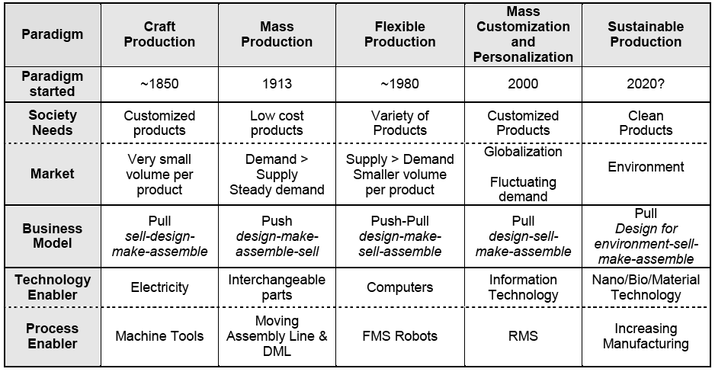
Key Transitions
What’s needed to make the last transition?
Automation
“F. W. Taylor”
Computer Aided
Manufacturing (CAM)
“M. E. Merchant”
Lean Manufacturing
“Toyoda, et al”
Positive Impact Manufacturing

Slide 33
New Employment Opportunity
Sustainable manufacturing offers uniquely new kind of employment opportunities:
Innovative 6R applications
Total life-cycle consideration
Sustainable manufacturing processes
Universities and colleges are well-positioned to provide educational and training programs
Undergraduate and graduate education
Non-credit professional continuing educational programs
Incentives must be provided to academic institutions and manufacturing companies to educate, train and develop the workforce for next generation manufacturing, and for conducting relevant fundamental and applied research.
New Employment Opportunities

Slide 34
Recommendation
Curriculum sift: Horizontal and vertical to include Lean, Clean & Green
An engaged technical community with the vision of changing the world through engineering education, innovation and practical action.
Supports community-driven development programs worldwide through the design and implementation of sustainable engineering projects, while fostering responsible leadership.
Established education resource center and training of instructors
Summer Engineering Experience in Development (SEED) Program for undergraduate volunteers
Annual conference for educators on how to incorporate sustainability into courses

Slide 35
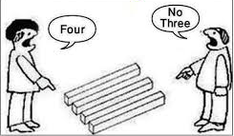
Thank You
yeakub.ali@utb.edu.bn

